Slide 1
MTU LUG
Last Meeting of the year
General Meeting 2015-12-10

Slide 2
Join lug-l

Slide 3
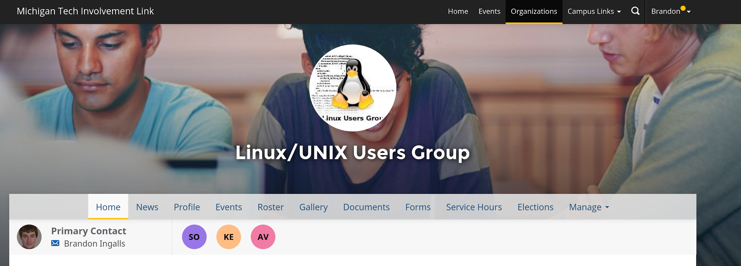
Join on Involvement
https://www.involvement.mtu.edu/organization/lug

Slide 4
Announcements
I lied about Elections
“Officers are elected for one-year terms”
https://lug.mtu.edu/constitution.html
Last meeting of the semester
Better meeting time
TBD

Slide 5
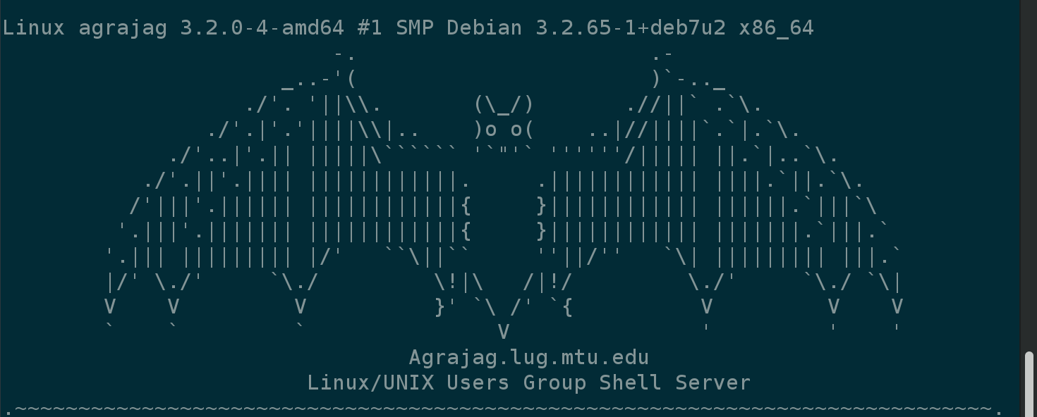
Shell Server
Account if
have been to three general meetings
shell.lug.mtu.edu

Slide 6
Users Forum
https://mtulug.slack.com/
http://adventofcode.com/

Slide 7
LetsEncrypt + Safe TLS Presentation

