Slide 1
MTU LUG
General Meeting 2016-02-26

Slide 2
Join lug-l

Slide 3
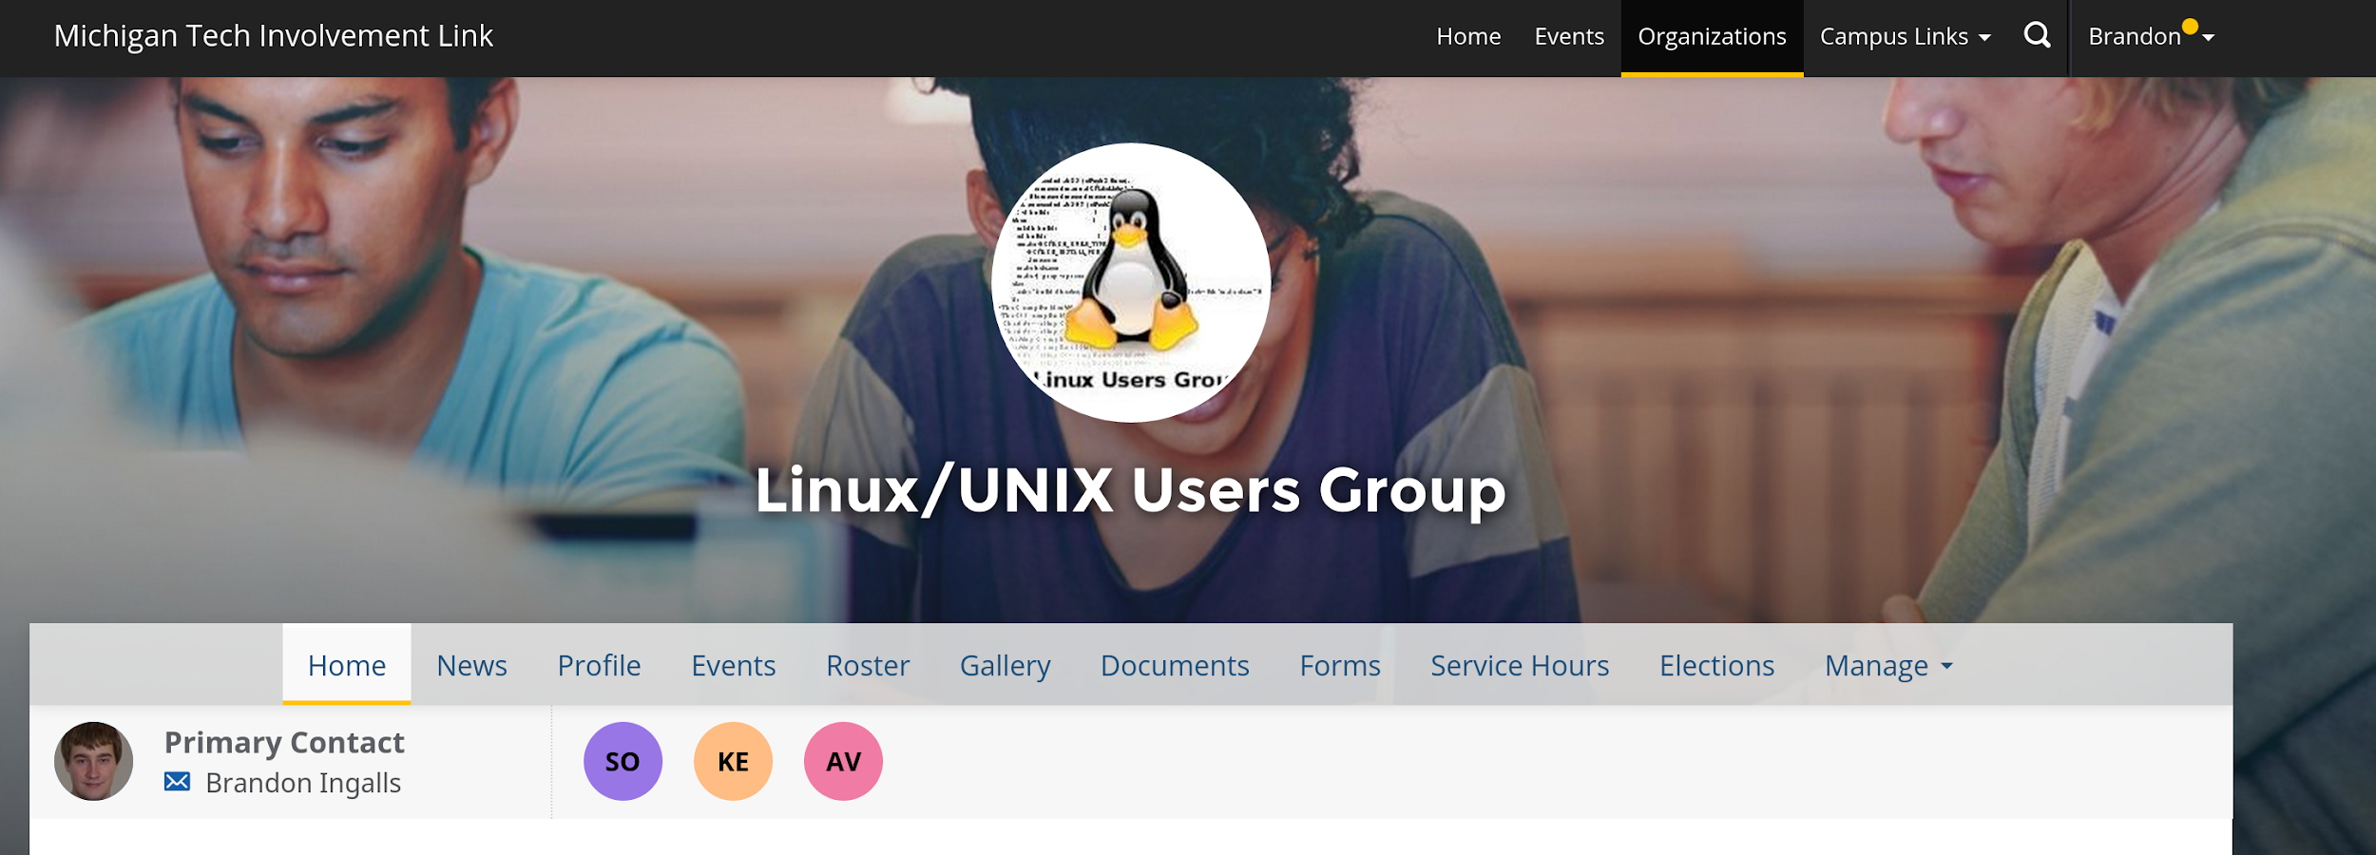
Join on Involvement
https://www.involvement.mtu.edu/organization/lug

Slide 4
Announcements
Shell Server is still currently down
I installed the “new” drives
Waiting on the Server Admins to rebuild

Slide 5
Users Forum
https://mtulug.slack.com/

Slide 6
Presentation: Application Whitelists
Presentation for MIS4990

