Slide 1
MTU LUG
2016-04-08

Slide 2
Join lug-l

Slide 3
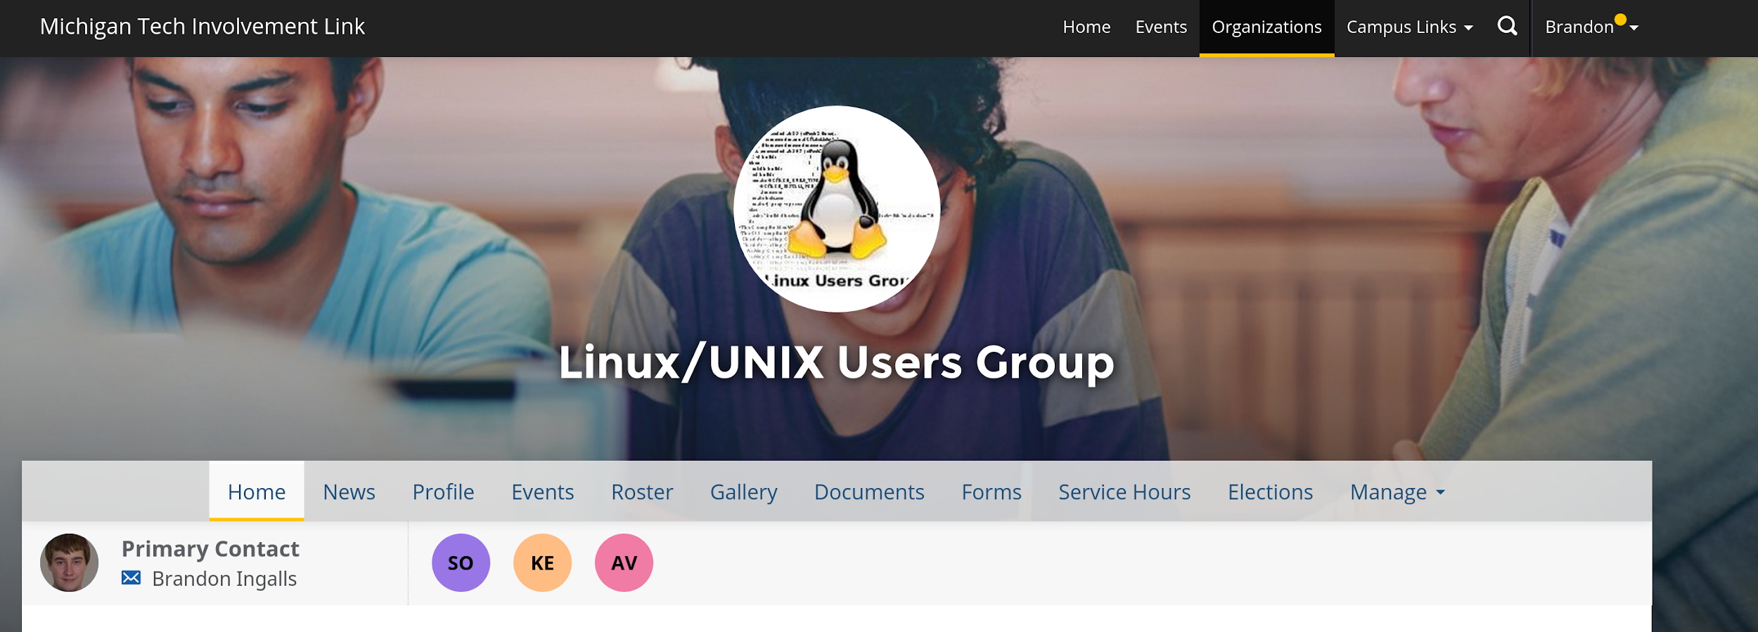
Join on Involvement
https://www.involvement.mtu.edu/organization/lug

Slide 4
Announcements
Shell Server is alive!!!
shell.lug.mtu.edu
need account?: lug-server-admins-l@mtu.edu
Data Recovery
If you need data from your old account
Get in contact with blingall
Will purge restored stuff April 9th

Slide 5
LUG eBoard Elections
Chris
Dan
Madi
Jake
Sysadmins
Matt Miller
Kory Wegmeyer
Todd Fox

Slide 6
Users Forum
https://mtulug.slack.com/

Slide 7
Packaging Demo

