Slide 1
MTU LUG
2016-04-22 Final meeting for the 2015-2016 school year

Slide 2
Join lug-l

Slide 3
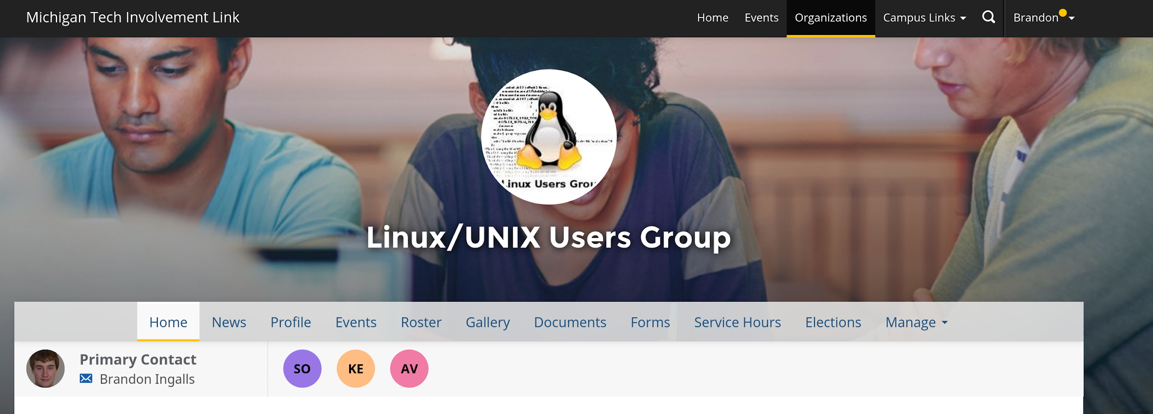
Join on Involvement
https://www.involvement.mtu.edu/organization/lug

Slide 4
Announcements
VM Host
We got new drives!

Slide 5
Users Forum
https://mtulug.slack.com/
QuickTime no-longer supported for Windows 8-)

Slide 6
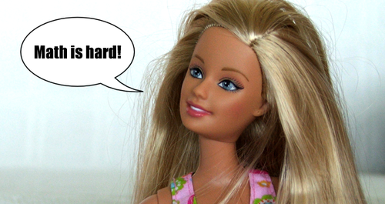
Study Hard Nerds!

Slide 7
Goodbye!

