Slide 1
MTU LUG
General Meeting

Slide 2
Announcements
One more meeting this semester
Nanocon?
nanocon-l@mtu.edu
Wednesday 6PM -- Fisher 131

Slide 3
eBoard Updates
Chris is AFK tonight
Server Team update

Slide 4
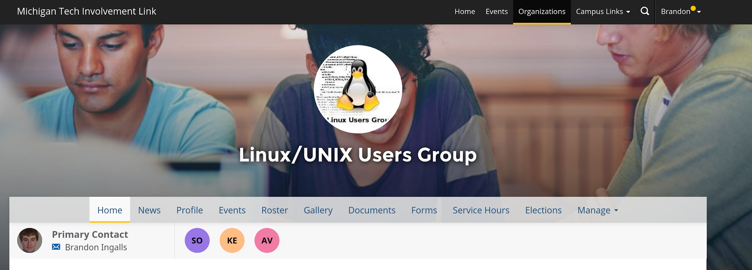
Join on Involvement
https://www.involvement.mtu.edu/organization/lug

Slide 5
Join lug-l
Join us on;
Slack mtulug.slack.com
Use mtu email
IRC
THESE ------------------>

Slide 6
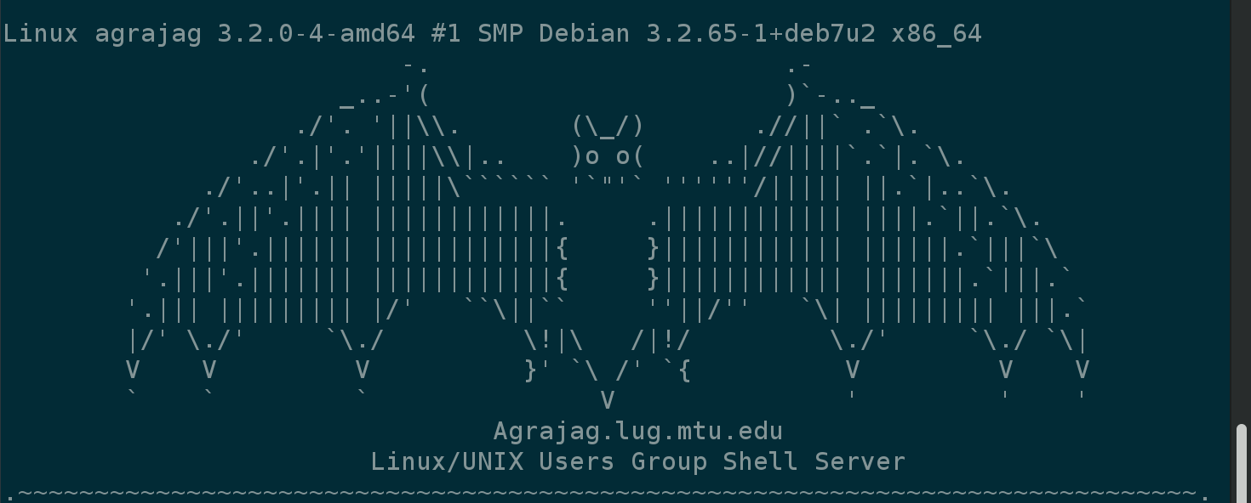
Shell Server
Account if
have been to three general meetings
shell.lug.mtu.edu

Slide 7
Fun-Time
What did you break this week

Slide 8
Presentation

Slide 9
Questions?
Any questions?

