Slide 1

Pipes!
Ronald Stempien
LUG@MTU

Slide 2
Interprocess Communication
Allows two processes to communicate with eachother
prog1 | prog2
“The output of prog1 is redirected to the input of prog2”

Slide 3
Subtleties
ls -l | grep .pdf
⌨️
ls -l
grep .pdf
🖥️
output…
output…
⌨️
ls -l
grep .pdf
🖥️
output…

Slide 4
The program is unaware of the pipe
grep’s stdout
ls’s stdin
ls -l
grep .pdf
output…
ls’s stdout = grep’s stdin
This means we can just use our normal I/O functions w/o any special considerations!

Slide 5
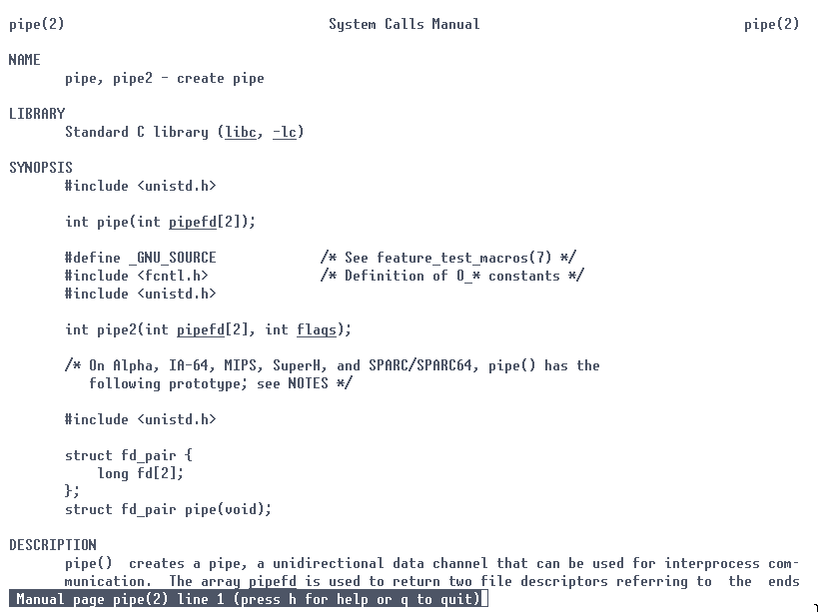
… but what are pipes, really?
We may think of pipes as a feature of our shell, but in reality they are an actual system call.

Slide 6
pipe()
Input - int fd[2]
pipe() populates the input array with two file descriptors fd[0] (read) and fd[1] (writing).
The return value is 0 if successful, and non-zero on some failure.
pipe2() does the same thing but takes an integer for options flags.

Slide 7
Everything is a file

Slide 8
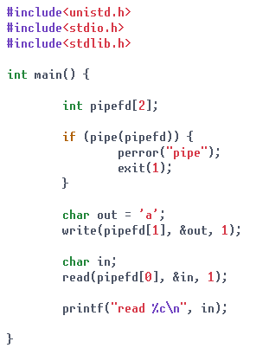

An example

Slide 9
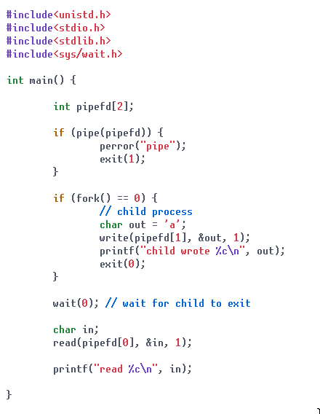
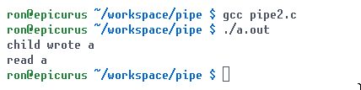
How can we use them between processes though?
fork() allows us to create a new child process that is an exact copy of the currently running process – including all the same file descriptors.

Slide 10
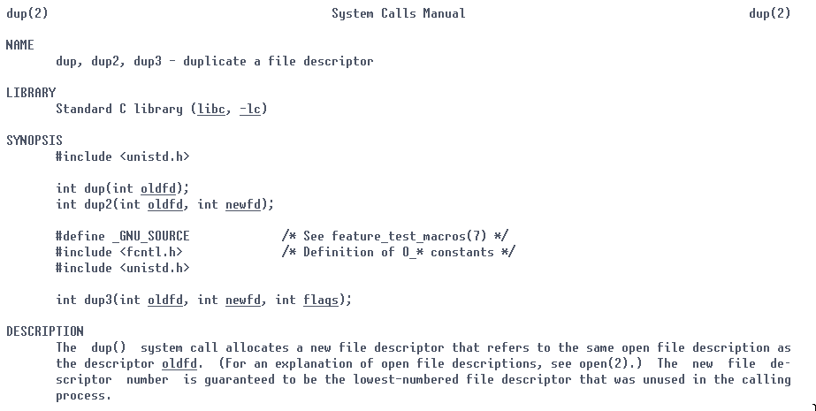
But how do we get it to act as stdin/stdout?
dup2() allows us to duplicate file descriptors, having one file descriptor (oldfd) pretend to be another file descriptor (newfd). Using this we can have one of our pipe file descriptors “take over” stdin/stdout.

Slide 11
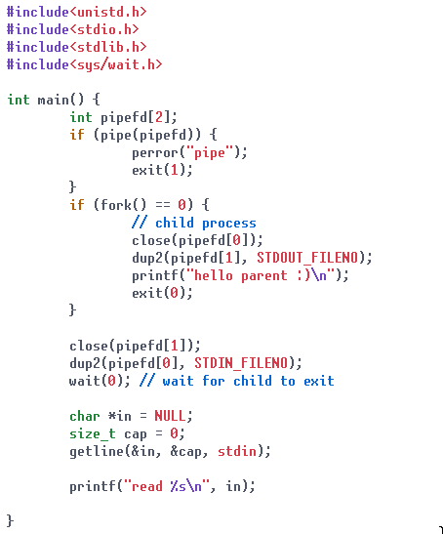

Example with dup2()

Slide 12
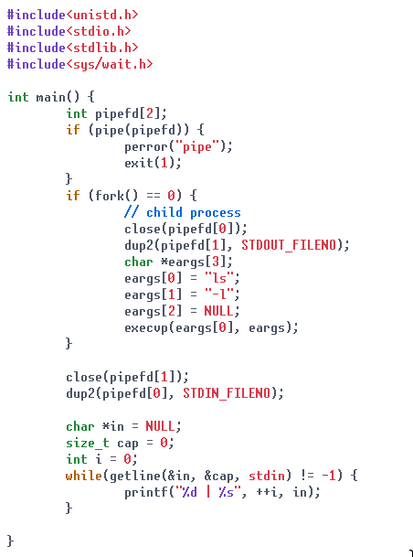
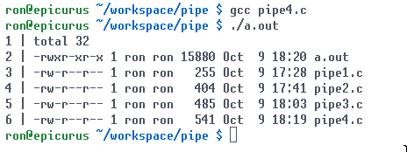
Adding in exec()
exec() replaces the current process’s address space with a new one (specified by the arguments)
However, exec() preserves open file descriptors*
*with a few exceptions

Slide 13
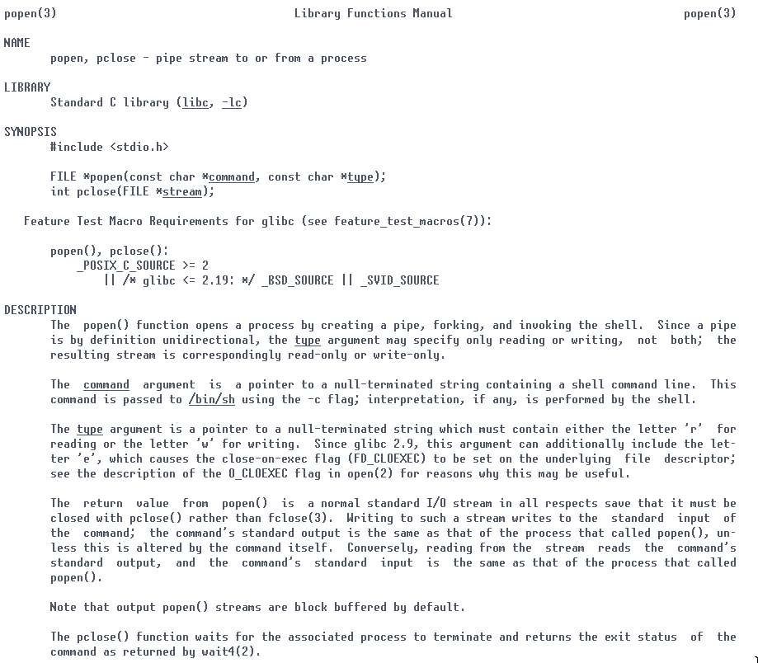
That’s a lot of work… Can we simplify further?
The whole pipe()-fork()-dup()-exec() pattern is common enough that we were given a specific C std library function to do it – popen()!

Slide 14
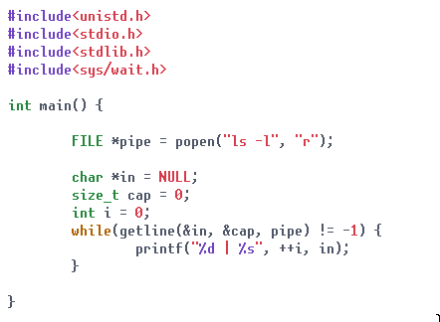
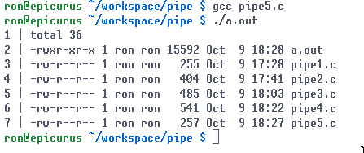
popen() example
Must be “r” or “w”, for which end of the pipe we want.

Slide 15
Named Pipes
The pipes we have been discussing are “anonymous” pipes, named pipes are created using the mkfifo program / systemcall
These are usually found in the /tmp/ directory.

Slide 16
Questions?

