Slide 1
Jellyfin, Containerization and the *arr suite
A LUG presentation on presenting and organizing public domain media

Slide 2
Plex and Jellyfin media server
Plex and jellyfin are Over-the-top media services (OTT TV)
They allow media paths to be defined and presented over client connections much like Netflix or other streaming services
User permissions can be managed, hardware transcoding for for efficient streaming, and all sorts of media types supported.

Slide 3
Hardware transcoding
Media is stored in container formats ranging from x264, x265, and more modern vp9 and av1.
These containers are compatible with different devices, and can hold/compress video.
The same idea is used with audio, (dane cameo?).

Slide 4
Physical server hardware
NVIDIA graphics cards will be used for hardware transcoding, including a GTX 1060 and 1070 8gb
These cards are pascal (1000 series, 2016) and support common
The server itself is a Dell R630, with 16 bays and 2 E5-2680 V4’s totaling 56 threads.

Slide 5
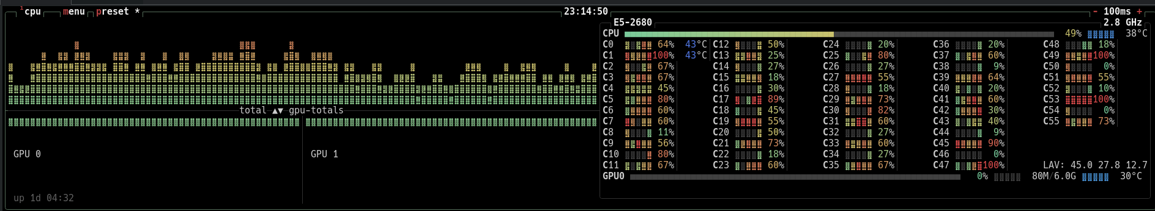
Volume mixer CPU screenshot

Slide 6
Storage/physical networking
Raid 1 MDAM and ZFS will be used for storage, with a pool of physical drives being organized into (zfs info...) pools/volumes/maps.
Debian 13’s boot drives are balanced between 2 500gb SSD’s in a raid 1 MDAM configuration.

Slide 7
Containers
Containers are similar to Virtual machines but use a shared kernel with the host.
Hardware can be passed in while still being available to the host, allowing for shared components between containers.
Mappings allow filesystem paths and network ports to be allocated for each container
Compose allows for a single config file to hold an entire stack, allowing for two commands to update/container replace

Slide 8
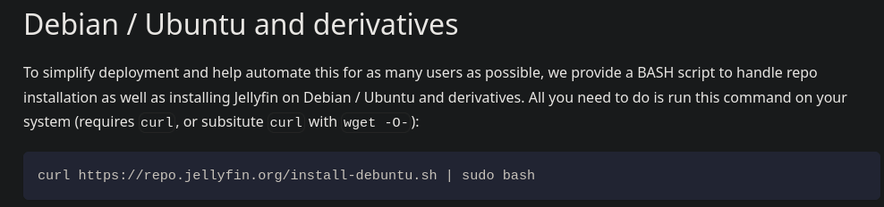
Jellyfin setup and Nvidia installation
Jellyfin can be set up with a one liner, while NVIDIA drivers require linux headers, a kernel module, and a 3rd party patch to unlock hardware transcoding.
Extra: Rffmpeg is a remote SSH ffmpeg Wrapper, allowing for remote hardware transcoding

Slide 9
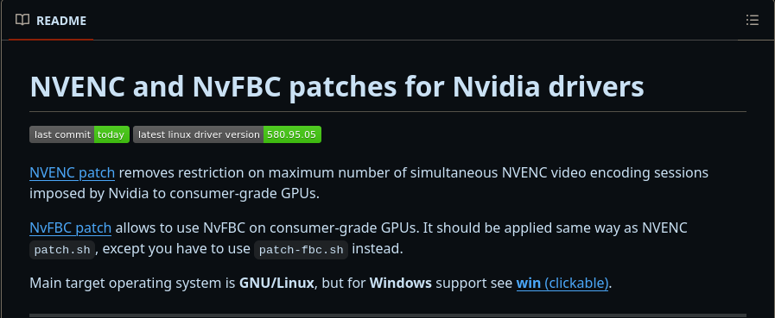

Slide 10
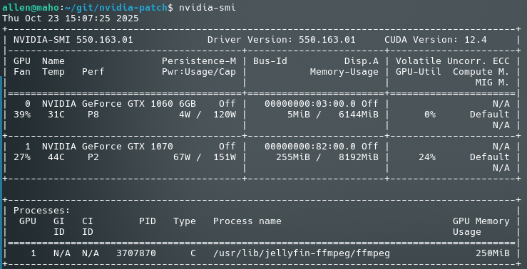
Nvidia-smi command Screenshot

Slide 11
*arr suite
The *arr suite organizes files into a structure that is nice for both administrators and jellyfin/plex to read.
They can create folders, move, and rename/retag files.
The *arr suite also allows queuing downloads by schedule or manually, searching for media (prowlarr), and sending the requests to a download client.
In a personal homelab, this allows full automation from request all the way to media import and showcase.

Slide 12
Jellyseer
Jellyseer manages requests for a jellyfin server, alternative to overseerr for plex.

Slide 13
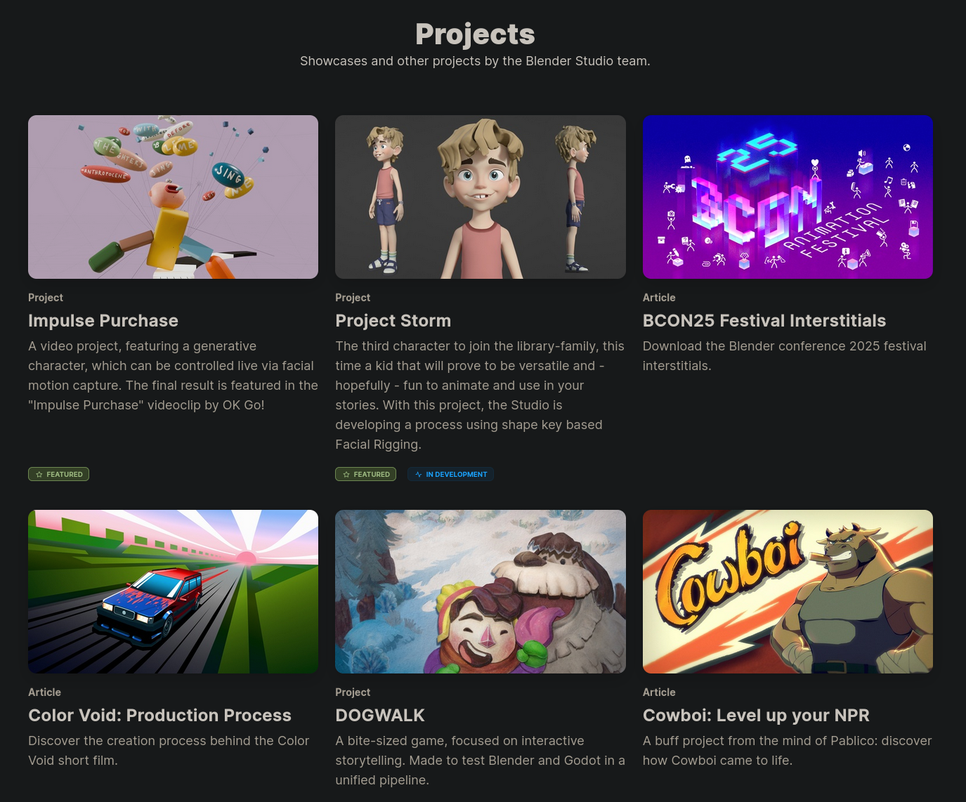
Blender Open Studio films
Blender open studio produces Creative Commons movies.
All assets/content of the movie is publicly accessible

Slide 14
Sources
https://en.wikipedia.org/wiki/Over-the-top_media_service
https://en.wikipedia.org/wiki/Comparison_of_video_container_formats
https://en.wikipedia.org/wiki/Pascal_(microarchitecture)
Noah Holland – Raid 1 and ZFS presentations
https://en.wikipedia.org/wiki/Containerization_(computing)
https://github.com/OliTechFR/Discovarr/

